Slide 1

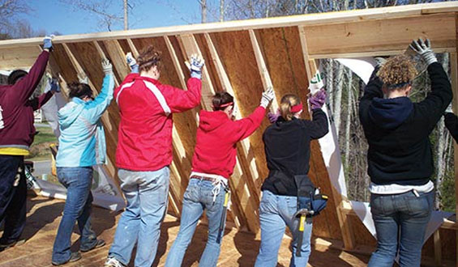
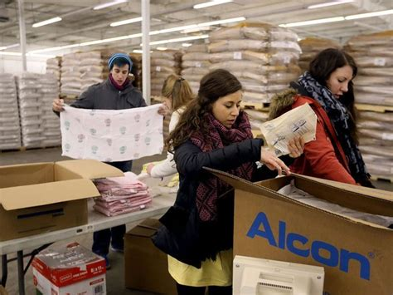


Title of Project
{Place name here}
{Graduation with Leadership Distinction in PATHWAY}
Beyond the Classroom
Title of My Beyond the Classroom Describe the context of your BTC Experience here. Your role/title, where your BTC engagement took place (name and purpose of organization if appropriate). How long you spent. Why you got involved, etc.
Activity/Description
What were the most significant things you did, what was the role/commitment level, who else did you interact with (peers, colleagues, mentors), details on what this experience involved.
Reflection (Analysis)
How did your BTC experience relate to your WTC experience, what else were you involved with that gave meaning to your experiences? You can either drill down to one class or focus on an overarching theme of your major courses.
Reflection cont.
What did I learn-deeper understanding of yourself, others, your studies, or your future career aspirations, how did your understanding of a concept change your experience?
Here are new questions I have now that I’ve learned this…
Conclusion
How does this experience and learning impact your own decisions for the future? What guiding principles are you going to take with you in whatever you decide to do? Here is what I want to do for my future and why?
This is also a good section to acknowledge anyone who was influential to your project.
Please note: The provided prompts for each section are not exhaustive. Please refer to GLD Presentations Expectations form for additional details.
References
In necessary, provide a list of references that are relevant to your project.
Word cloud. Digital Image. Web. January 17, 2018. <eventespresso.com>
People raising fence. Digital image. August 2012. Web. January 17, 2018. <www.educationnews.org>
Packing food boxes. Digital image. Web. January 17, 2018. <www.gannett-cdn.com>

Slide 2
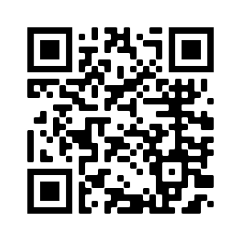

Title of Project
{Place name here}
{Graduation with Leadership Distinction in PATHWAY}
Beyond the Classroom
Title of My Beyond the Classroom Describe the context of your BTC Experience here. Your role/title, where your BTC engagement took place (name and purpose of organization if appropriate). How long you spent. Why you got involved, etc.
Photo
Activity/Description
What were the most significant things you did, what was the role/commitment level, who else did you interact with (peers, colleagues, mentors), details on what this experience involved.
Reflection (Analysis)
How did your BTC experience relate to your WTC experience, what else were you involved with that gave meaning to your experiences? You can either drill down to one class or focus on an overarching theme of your major courses.
Photo
Reflection cont.
What did I learn-deeper understanding of yourself, others, your studies, or your future career aspirations, how did your understanding of a concept change your experience?
Here are new questions I have now that I’ve learned this…
Photo
Conclusion
How does this experience and learning impact your own decisions for the future? What guiding principles are you going to take with you in whatever you decide to do? Here is what I want to do for my future and why?
This is also a good section to acknowledge anyone who was influential to your project.
Please note: The provided prompts for each section are not exhaustive. Please refer to GLD Presentations Expectations form for additional details.
Photo
Find out more information about me and my experiences at UofSC: www.eportfolios.com/andrewrsmith
arsmith@sc.edu

Slide 3
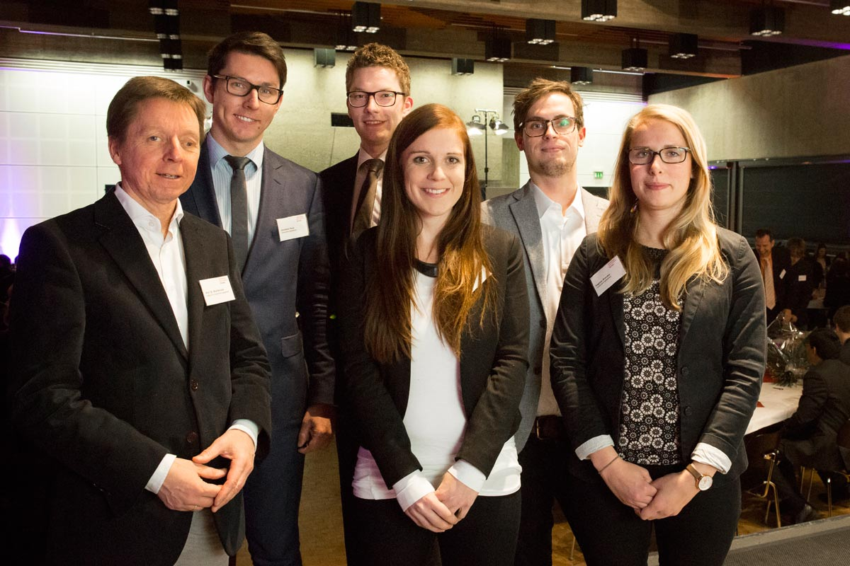
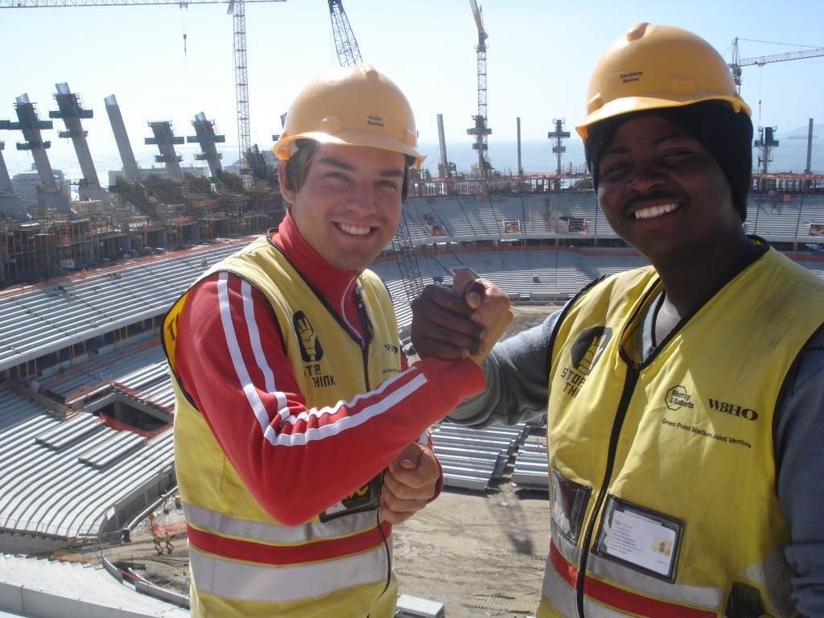

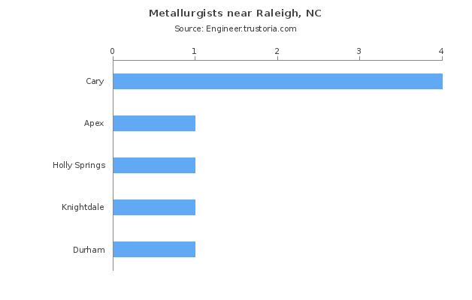

Title of the Project
{Place name here}
{Graduation with Leadership Distinction in PATHWAY}
Beyond the Classroom
Title of My Beyond the Classroom Describe the context of your BTC Experience here. Your role/title, where your BTC engagement took place (name and purpose of organization if appropriate). How long you spent. Why you got involved.
Activity/Description
What were the most significant things you did, what was the role/commitment level, who else did you interact with (peers, colleagues, mentors), details on what this experience involved.
Conclusion
How does this experience and learning impact your own decisions for the future? What guiding principles are you going to take with you in whatever you decide to do? Here is what I want to do for my future and why?
This is also a good section to acknowledge anyone who was influential to your project.
Please note: The provided prompts for each section are not exhaustive. Please refer to GLD Presentations Expectations form for additional details.
Reflection (Analysis)
How did your BTC experience relate to your WTC experience, what else were you involved with that gave meaning to your experiences? You can either drill down to one class or focus on an overarching theme of your major courses.
References
In necessary, provide a list of references that are relevant to your project.
Meet and greet event. Digital image. Web. January 17, 2018. <www.th-koeln.de>
Colleagues at worksite. Digital image. February 2014. Web. January 17, 2018. <www.vacorps.com>
Advanced technology equipment. Digital image. June 6, 2014. Web. January 17, 2018. <ww1.prweb.com>

Slide 4
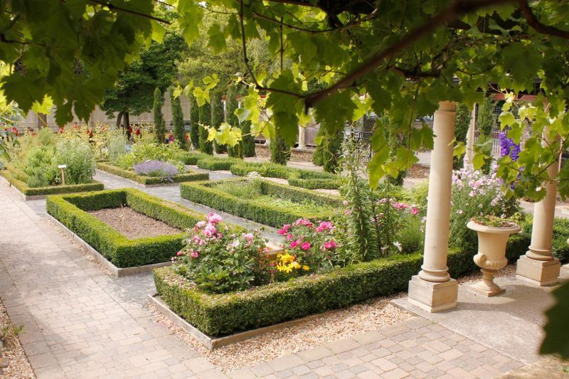

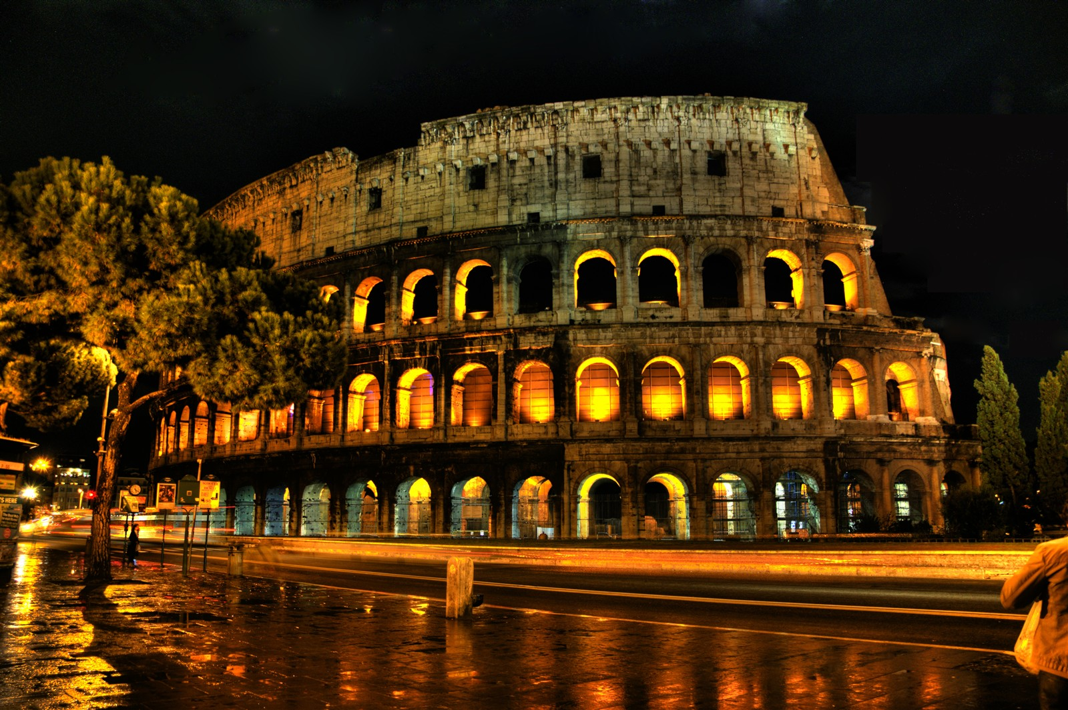
Title of the Project
{Place name here}
{Graduation with Leadership Distinction in PATHWAY}
Beyond the Classroom
Title of My Beyond the Classroom Describe the context of your BTC Experience here. Your role/title, where your BTC engagement took place (name and purpose of organization if appropriate). How long you spent. Why you got involved, etc.
Activity/Description
What were the most significant things you did, what was the role/commitment level, who else did you interact with (peers, colleagues, mentors), details on what this experience involved.
Reflection (Analysis)
How did your BTC experience relate to your WTC experience, what else were you involved with that gave meaning to your experiences? You can either drill down to one class or focus on an overarching theme of your major courses.
Conclusion
How does this experience and learning impact your own decisions for the future? What guiding principles are you going to take with you in whatever you decide to do? Here is what I want to do for my future and why?
This is also a good section to acknowledge anyone who was influential to your project.
Please note: The provided prompts for each section are not exhaustive. Please refer to GLD Presentations Expectations form for additional details.
References
In necessary, provide a list of references that are relevant to your project.
Rome coliseum. Digital image. June 2014. Web. January 17, 2018. <blog.rome-accommodation.net>
Garden in Rome. Digital image. Web. January 17, 2018. <museum.wales>
Greece. Digital image. Web. January 17, 2018. <amfblog.s3amazonaws.com>

Slide 5
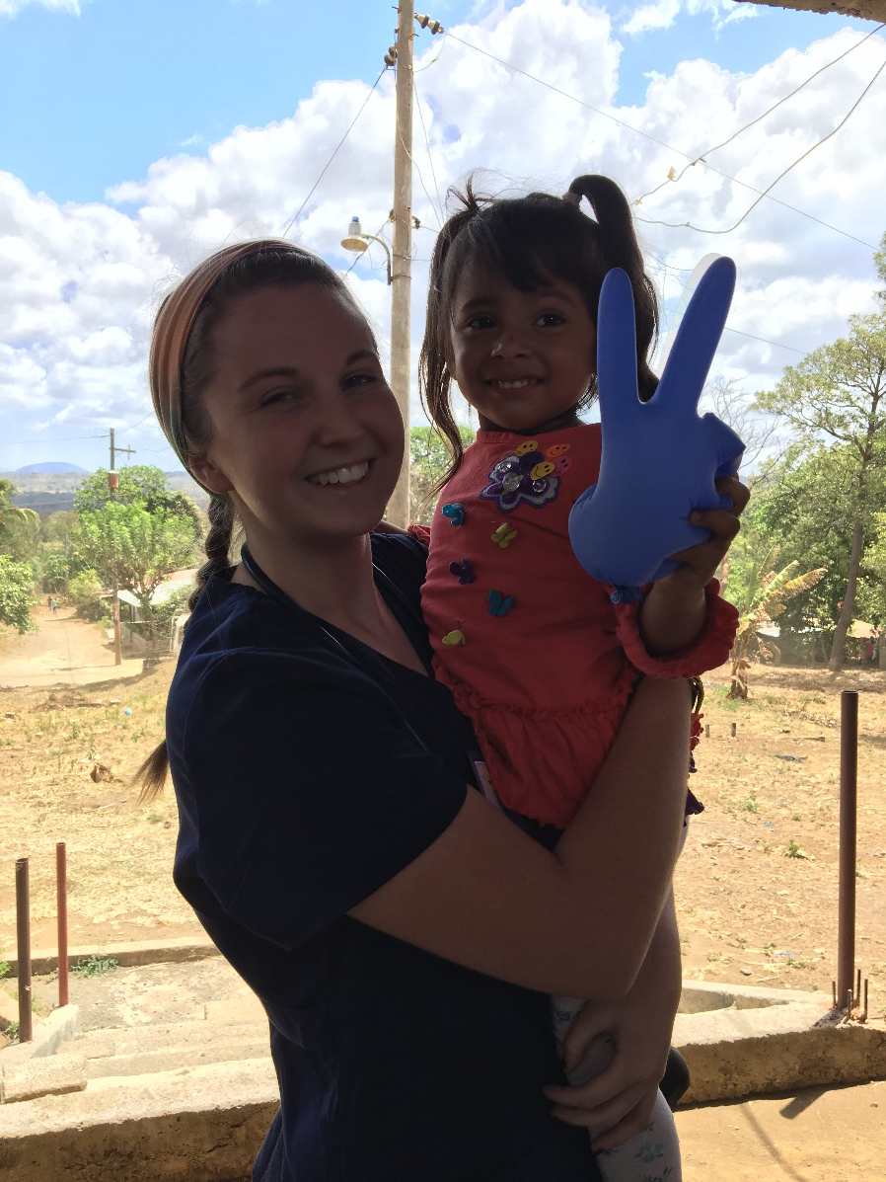
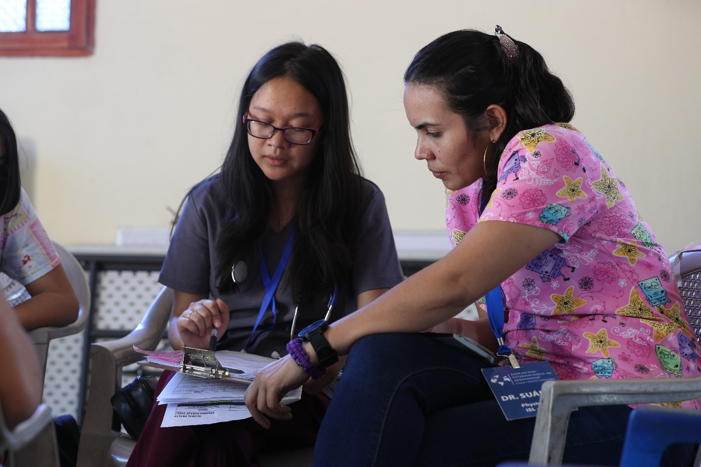
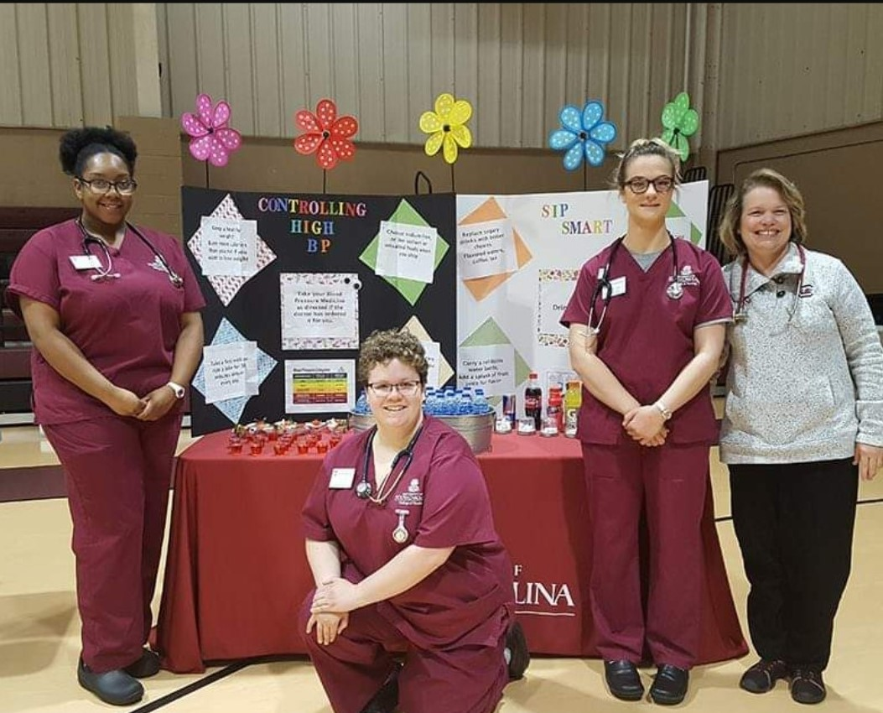
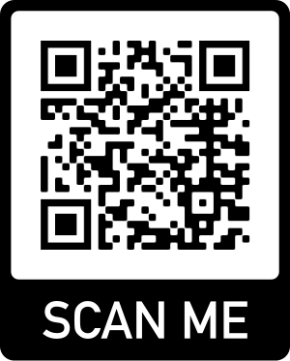

Title of Project
{Place name here}
{Graduation with Leadership Distinction in PATHWAY}
Reflection (Analysis)
How did your BTC experience relate to your WTC experience, what else were you involved with that gave meaning to your experiences? You can either drill down to one class or focus on an overarching theme of your major courses.
Main finding goes here, translated into plain English.
Emphasize the important words.
Beyond the Classroom
Title of My Beyond the Classroom Describe the context of your BTC Experience here. Your role/title, where your BTC engagement took place (name and purpose of organization if appropriate). How long you spent. Why you got involved, etc.
Reflection cont.
What did I learn-deeper understanding of yourself, others, your studies, or your future career aspirations, how did your understanding of a concept change your experience?
Here are new questions I have now that I’ve learned this…
Activity and Description
What were the most significant things you did, what was the role/commitment level, who else did you interact with (peers, colleagues, mentors), details on what this experience involved.
Conclusion
How does this experience and learning impact your own decisions for the future? What guiding principles are you going to take with you in whatever you decide to do? Here is what I want to do for my future and why?
This is also a good section to acknowledge anyone who was influential to your project.
Please note: The provided prompts for each section are not exhaustive. Please refer to GLD Presentations Expectations form for additional details.
Include a QR code that leads to your ePortfolio, or project.

Slide 6


Particularly Long Title to Your Graduation with Leadership Distinction Presentation
Andrew R. Smith
University of South Carolina
Beyond the Classroom
Title of My Beyond the Classroom Describe the context of your BTC Experience here. Your role/title, where your BTC engagement took place (name and purpose of organization if appropriate). How long you spent. Why you got involved, etc.
Reflection cont.
What did I learn-deeper understanding of yourself, others, your studies, or your future career aspirations, how did your understanding of a concept change your experience?
Here are new questions I have now that I’ve learned this…
Main finding goes here, translated into plain English.
Emphasize the important words.
Main finding goes here, translated into plain English.
Emphasize the important words.
Activity and Description
What were the most significant things you did, what was the role/commitment level, who else did you interact with (peers, colleagues, mentors), details on what this experience involved.
Conclusion
How does this experience and learning impact your own decisions for the future? What guiding principles are you going to take with you in whatever you decide to do? Here is what I want to do for my future and why?
This is also a good section to acknowledge anyone who was influential to your project.
Please note: The provided prompts for each section are not exhaustive. Please refer to GLD Presentations Expectations form for additional details.
Reflection (Analysis)
How did your BTC experience relate to your WTC experience, what else were you involved with that gave meaning to your experiences? You can either drill down to one class or focus on an overarching theme of your major courses.
Insert small logos or graphics for emphasis.
Generate QR codes here:
https://www.qrcode-monkey.com/

Slide 7

Main finding goes here, translated into plain English. Emphasize the important words.
Customizing Your Poster Size
Create a vertical poster by customizing your slide size.
To set a custom size:
Select ‘Design’ in the ribbon.
Choose ‘Slide Size’ in the Customize section.
Select “Custom Slide Size…”
The width of your poster should be no larger than 42”. The height should be no larger than 48”
NOTE: Larger posters cost more. The minimum 24” height and 36” length will be your best value.
Title goes here; make it small if you need to free up space.
{Place name here}
{Graduation with Leadership Distinction in PATHWAY}
Beyond the Classroom
Title of My Beyond the Classroom Describe the context of your BTC Experience here. Your role/title, where your BTC engagement took place (name and purpose of organization if appropriate). How long you spent. Why you got involved, etc.
Activity and Description
What were the most significant things you did, what was the role/commitment level, who else did you interact with (peers, colleagues, mentors), details on what this experience involved.
Maximum height is 48”
Reflection (Analysis)
How did your BTC experience relate to your WTC experience, what else were you involved with that gave meaning to your experiences? You can either drill down to one class or focus on an overarching theme of your major courses.
Reflection cont.
What did I learn-deeper understanding of yourself, others, your studies, or your future career aspirations, how did your understanding of a concept change your experience?
Here are new questions I have now that I’ve learned this…
Conclusion
How does this experience and learning impact your own decisions for the future? What guiding principles are you going to take with you in whatever you decide to do? Here is what I want to do for my future and why?
This is also a good section to acknowledge anyone who was influential to your project.
Please note: The provided prompts for each section are not exhaustive. Please refer to GLD Presentations Expectations form for additional details.
Find out more information about me and my experiences at UofSC: www.eportfolios.com/andrewrsmith
arsmith@sc.edu
Poster is still 36” wide, but now taller for more space.

